Slide 1
Spark’s Toolset

Slide 2
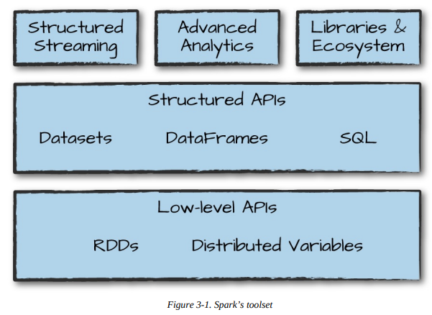
Spark’s Toolset Introduction
we introduced Spark’s core concepts, like transformations and actions, in the context of Spark’s Structured APIs. These simple conceptual building blocks are the foundation of Apache Spark’s vast ecosystem of tools and libraries (Figure 3-1). Spark is composed of these primitives—the lower-level APIs and the Structured APIs—and then a series of standard libraries for additional functionality.

Slide 3
Spark’s libraries support a variety of different tasks, from graph analysis and machine learning to streaming and integrations with a host of computing and storage systems.
This chapter presents a whirlwind tour of much of what Spark has to offer, including some of the APIs we have not yet covered and a few of the main libraries.
For each section, you will find more detailed information in other parts of this book(Spark Definitive Guide); our purpose here is provide you with an overview of what’s possible.
This chapter covers the following:
Running production applications with spark-submit
Datasets: type-safe APIs for structured data
Structured Streaming
Machine learning and advanced analytics
Resilient Distributed Datasets (RDD): Spark’s low level APIs
SparkR
The third-party package ecosystem

Slide 4
Running Production Applications
Spark makes it easy to develop and create big data programs. Spark also makes it easy to turn your interactive exploration into production applications with spark-submit, a built-in command-line tool.
The spark-submit command is a powerful utility tool to run or submit a Spark or PySpark application program (or job) locally or in a cluster by specifying options and configurations;
The application you are submitting can be written in Scala, Java, or Python (PySpark)
spark-submit does one thing: it lets you send your application code to a cluster and launch it to execute there. Upon submission, the application will run until it exits (completes the task) or encounters an error.
You can do this with all of Spark’s support cluster managers including Standalone, Mesos, and YARN.

Slide 5
In this class, I will explain the spark-submit syntax, different command options, advanced configurations, and how to use an user jar or zip file for Scala and Java, use Python .py file, and finally, submit the application on Yarn, Mesos, Kubernetes, and standalone cluster managers. I will cover everything you need to know to run your applications successfully using the spark-submit command.
At a high level, you need to know that the spark-submit command supports the following.
1. Submitting Spark applications on different cluster managers like Yarn, Kubernetes, Mesos, and Stand-alone.
2. Submitting Spark application on client or cluster deployment modes.

Slide 6
1. Spark Submit Command
Spark binary comes with spark-submit.sh script file for Linux, Mac, and spark-submit.cmd command file for windows, these scripts are available at $SPARK_HOME/bin directory.
If you are using Cloudera distribution, you may also find spark2-submit.sh which is used to run Spark 2.x applications. By adding this Cloudera supports both Spark 1.x and Spark 2.x applications to run in parallel.
spark-submit command internally uses org.apache.spark.deploy.SparkSubmit class with the options and command line arguments you specify.

Slide 7
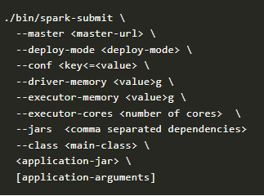
Below is a spark-submit command with the most-used command options.
You can also submit the application like below without using the script.
./bin/spark-class org.apache.spark.deploy.SparkSubmit <options & arguments>

Slide 8

The simplest example is running an application on your local machine. We’ll show this by running a sample Scala application that comes with Spark, using the following command in the directory where you downloaded Spark:
This sample application calculates the digits of pi to a certain level of estimation. Here, we’ve told spark-submit that we want to run on our local machine, which class and which JAR we would like to run, and some command-line arguments for that class.

Slide 9
We can also run a Python version of the application using the following command:
./bin/spark-submit \
--master local \
./examples/src/main/python/pi.py 10
By changing the master argument of spark-submit, we can also submit the same application to a cluster running Spark’s standalone cluster manager, Mesos or YARN.

Slide 10
2. Spark Submit Options
Below I have explained some of the common options, configurations, and specific options to use with Scala and Python. You can also get all options available by running the below command.
./bin/spark-submit –help
2. 1 Deployment Modes (–deploy-mode)
Using --deploy-mode, you specify where to run the Spark application driver program. Spark support cluster and client deployment modes.
VALUE DESCRIPTION
cluster In cluster mode, the driver runs on one of the worker nodes, and this node shows as a driver on the Spark Web UI of your application. cluster mode is used to run production jobs.
client In client mode, the driver runs locally where you are submitting your application from. client mode is majorly used for interactive and debugging purposes. Note that in client mode only the driver runs locally and all other executors run on different nodes on the cluster.

Slide 11
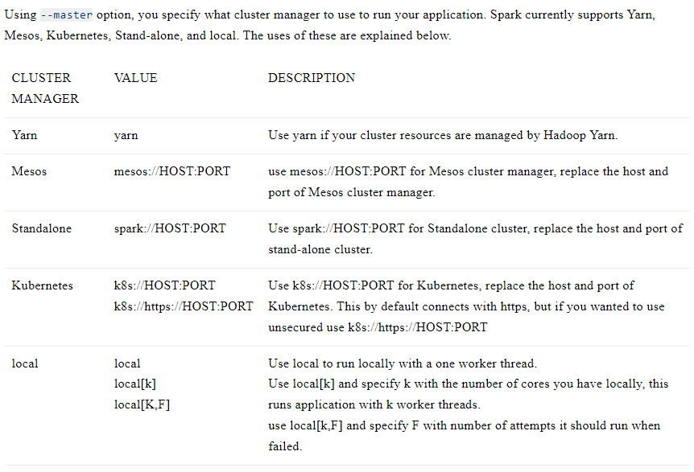
2.2 Cluster Managers (--master)

Slide 12
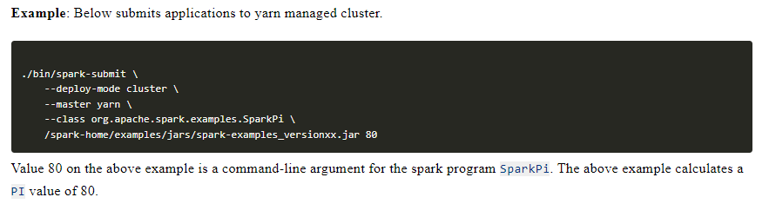
Example

Slide 13
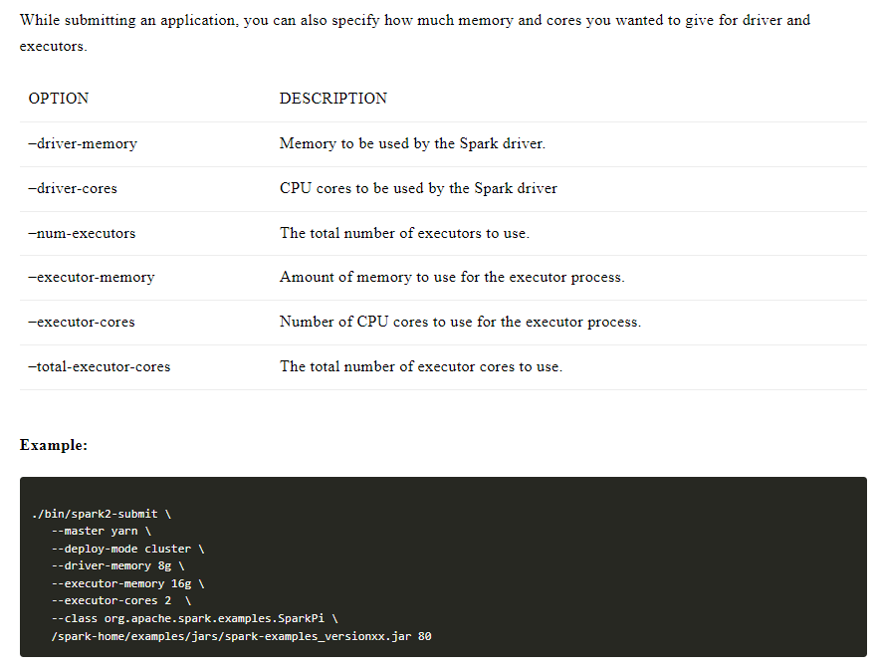
2.3 Driver and Executor Resources (Cores & Memory

Slide 14
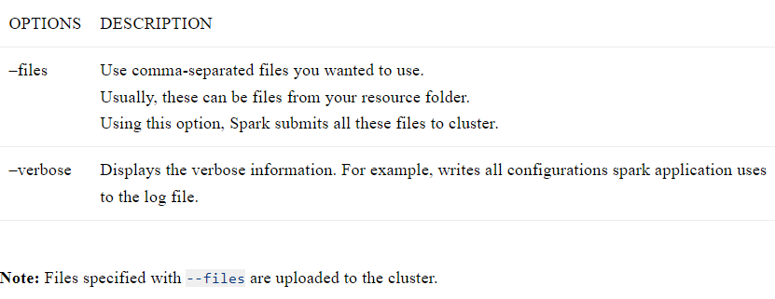
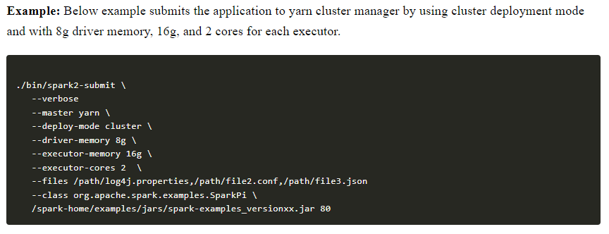
2.4 Other Options

Slide 15
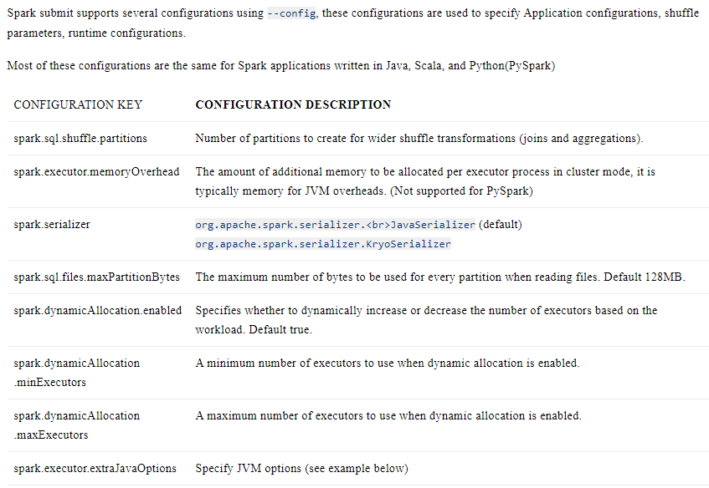
3. Spark Submit Configurations

Slide 16
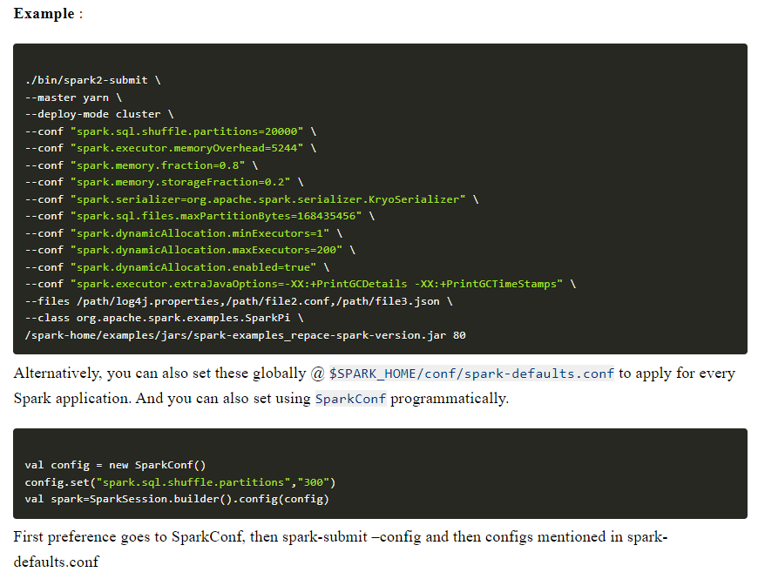

Slide 17
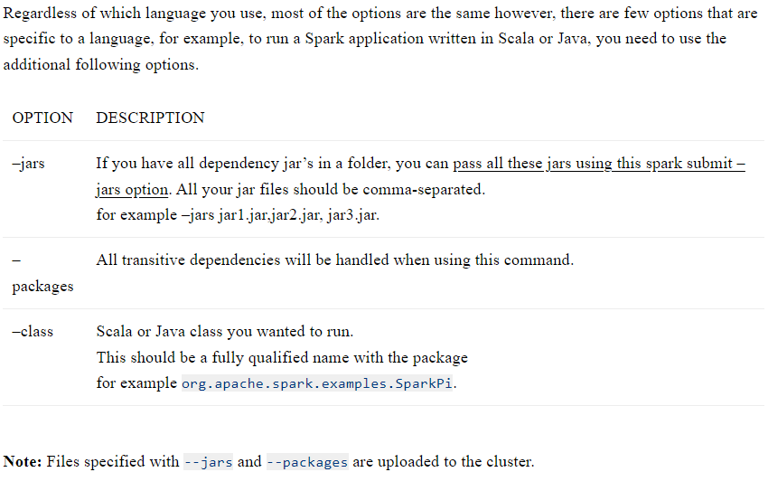
4. Submit Scala or Java Application

Slide 18
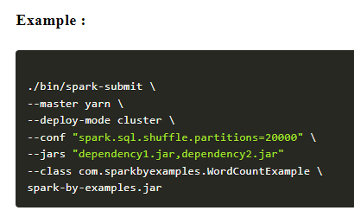
Submit Scala or Java Application Example

Slide 19
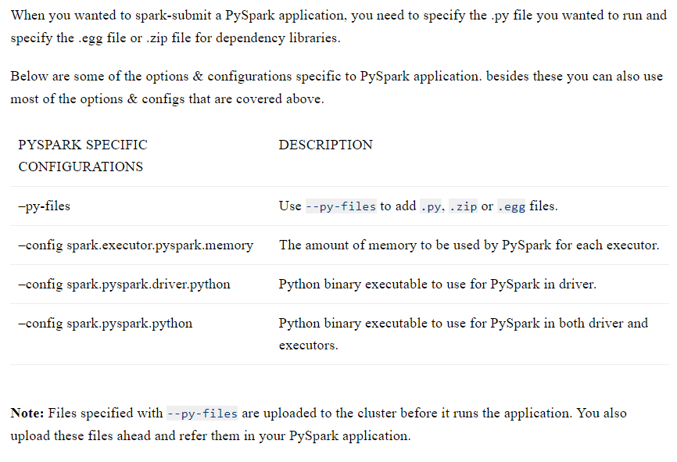
5. Spark Submit PySpark (Python) Application

Slide 20
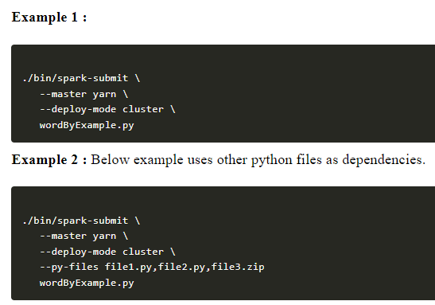
5. Spark Submit PySpark (Python) Application example

Slide 21
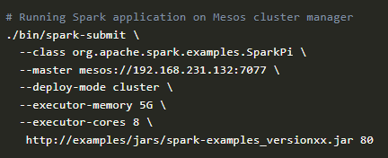
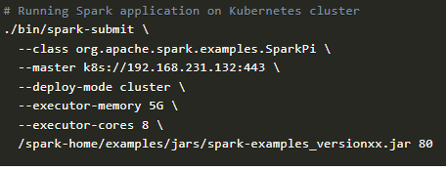
6 and 7. Submitting Application to Mesos and Kubernetes
Here, we are submitting spark application on a Mesos-managed cluster and Kubernetes managed cluster using deployment mode with 5G memory and 8 cores for each executor.
Mesos: Kubernetes:

Slide 22
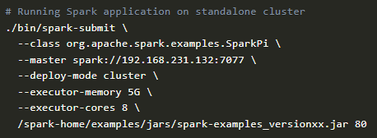
8. Submitting Application to Standalone
The below example runs Spark application on a Standalone cluster using cluster deployment mode with 5G memory and 8 cores for each executor.

Slide 23
Administrative Tasks:
In addition to submitting Spark applications, Spark Submit also provides several other functionalities. It can be used to run Spark’s built-in examples, test Spark applications, and perform other administrative tasks such as deploying and managing Spark clusters.
Conclusion:
In conclusion, Spark Submit is a command-line tool that is an integral part of the Spark ecosystem. It allows users to submit Spark applications to a cluster for execution and provides various functionalities such as running examples, testing applications, and performing administrative tasks. By being able to specify configuration parameters and handling the complexities of the distributed environment, Spark Submit makes it easier for users to develop, test, and deploy their Spark applications.

Slide 24
https://sparkbyexamples.com/spark/spark-submit-command/

Slide 25
Datasets: Type-Safe Structured APIs
The first API we’ll describe is a type-safe version of Spark’s structured API called Datasets, for writing statically typed code in Java and Scala. The Dataset API is initially not available in Python and R but now available, because those languages are dynamically typed.
Recall that DataFrames, which we saw in the previous chapter, are a distributed collection of objects of type Row that can hold various types of tabular data.
The Dataset API gives users the ability to assign a Java/Scala class to the records within a DataFrame and manipulate it as a collection of typed objects, similar to a Java ArrayList or Scala Seq.
The APIs available on Datasets are type-safe. In simple terms, "type-safe" in Spark Datasets means that the data types of the columns are enforced and checked at compile-time. This ensures that you're working with the correct types of data, reducing the chance of runtime errors related to data types.

Slide 26
The Dataset class is parameterized with the type of object contained inside: Dataset<T> in Java and Dataset[T] in Scala.
For example, a Dataset[Person] will be guaranteed to contain objects of class Person. As of Spark 2.0, the supported types are classes following the JavaBean pattern in Java and case classes in Scala.
These types are restricted because Spark needs to be able to automatically analyze the type T and create an appropriate schema for the tabular data within your Dataset.

Slide 27
One great thing about Datasets is that you can use them only when you need or want to.
For instance, in the following example, we’ll define our own data type and manipulate it via arbitrary map and filter functions. After we’ve performed our manipulations, Spark can automatically turn it back into a DataFrame, and we can manipulate it further by using the hundreds of functions that Spark includes.
This makes it easy to drop down to lower level, perform type-safe coding when necessary, and move higher up to SQL for more rapid analysis. Here is a small example showing how you can use both type-safe functions and DataFrame-like SQL expressions to quickly write business logic:

Slide 28
Dataset example
# Define a case class for the Person schema
from pyspark.sql.types import StructType, StructField, IntegerType, StringType
Person = Row("id", "name", "age")
# Create a Dataset from the list of Person objects
people_ds = spark.createDataFrame(data, schema=StructType([
StructField("id", IntegerType(), True),
StructField("name", StringType(), True),
StructField("age", IntegerType(), True)
])).as[Person]
# Print the Dataset
people_ds.show()
# Filter and display people older than 30
filtered_ds = people_ds.filter(people_ds.age > 30)
filtered_ds.show()
# Stop the Spark session
spark.stop()
from pyspark.sql import SparkSession
from pyspark.sql import Row
# Create a Spark session
spark = SparkSession.builder \
.appName("TypeSafeDatasetExample") \
.getOrCreate()
# Define data as a list of Row objects
data = [ Row(id=1, name='Alice', age=30),
Row(id=2, name='Bob', age=25),
Row(id=3, name='Charlie', age=35) ]
# Create a DataFrame from the list of Rows
df = spark.createDataFrame(data)
# Convert DataFrame to a Dataset of Person objects using asDict()
from pyspark.sql.functions import asDict
people_ds = df.select(asDict(df.schema)).rdd.map(lambda row: Row(**row)).toDS()

Slide 29
// in Scala
case class Flight(DEST_COUNTRY_NAME: String,
ORIGIN_COUNTRY_NAME: String,
count: BigInt)
val flightsDF = spark.read
.parquet("/data/flight-data/parquet/2010-summary.parquet/")
val flights = flightsDF.as[Flight]

Slide 30
One final advantage is that when you call collect or take on a Dataset, it will collect objects of the proper type in your Dataset, not DataFrame Rows. This makes it easy to get type safety and securely perform manipulation in a distributed and a local manner without code changes:
// in Scala
flights
.filter(flight_row => flight_row.ORIGIN_COUNTRY_NAME != "Canada")
.map(flight_row => flight_row)
.take(5)
flights
.take(5)
.filter(flight_row => flight_row.ORIGIN_COUNTRY_NAME != "Canada")
.map(fr => Flight(fr.DEST_COUNTRY_NAME, fr.ORIGIN_COUNTRY_NAME, fr.count + 5))

Slide 34
Machine Learning and Advanced Analytics
Another popular aspect of Spark is its ability to perform large-scale machine learning with a built-in library of machine learning algorithms called MLlib.
MLlib allows for preprocessing, munging, training of models, and making predictions at scale on data.
You can even use models trained in MLlib to make predictions in Strucutred Streaming. Spark provides a sophisticated machine learning API for performing a variety of machine learning tasks, from classification toregression, and clustering to deep learning.
To demonstrate this functionality, we will perform some basic clustering on our data using a standard algorithm called k-means.

Slide 35
WHAT IS K-MEANS?
k-means is a clustering algorithm in which “k” centers are randomly assigned within the data.
Thepoints closest to that point are then “assigned” to a class and the center of the assigned points is computed. This center point is called the centroid.
We then label the points closest to that centroid, to the centroid’s class, and shift the centroid to the new center of that cluster of points.
We repeat this process for a finite set of iterations or until convergence (our center points stop changing).

Slide 36
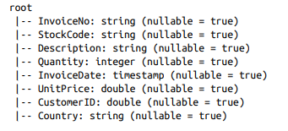
Spark includes a number of preprocessing methods out of the box. To demonstrate these methods, we will begin with some raw data, build up transformations before getting the data into the right format, at which point we can actually train our model and then serve predictions:
staticDataFrame.printSchema()

Slide 37
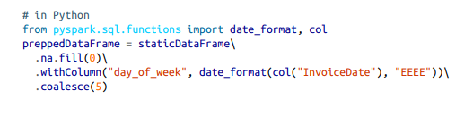
Machine learning algorithms in MLlib require that data is represented as numerical values. Our current data is represented by a variety of different types, including timestamps, integers, and strings. Therefore we need to transform this data into some numerical representation. In this instance, we’ll use several DataFrame transformations to manipulate our date data:

Slide 38

We are also going to need to split the data into training and test sets. In this instance, we are going to do this manually by the date on which a certain purchase occurred; however, we could also use MLlib’s transformation APIs to create a training and test set via train validation splits or cross validation
Now that we’ve prepared the data, let’s split it into a training and test set. Because this is a time–
series set of data, we will split by an arbitrary date in the dataset. Although this might not be the
optimal split for our training and test, for the intents and purposes of this example it will work
just fine.
We’ll see that this splits our dataset roughly in half:
trainDataFrame.count()
testDataFrame.count()

Slide 39
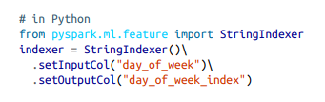

Spark’s MLlib also provides a number of transformations with which we can automate some of our general transformations. One such transformer is a StringIndexer:
This will turn our days of weeks into corresponding numerical values.
For example, Spark might represent Saturday as 6, and Monday as 1. However, with this numbering scheme, we are implicitly stating that Saturday is greater than Monday (by pure numerical values). This is obviously incorrect.
To fix this, we therefore need to use a OneHotEncoder to encode each of
these values as their own column. These Boolean flags state whether that day of week is the
relevant day of the week

Slide 40
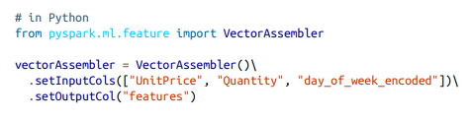
Each of these will result in a set of columns that we will “assemble” into a vector. All machine learning algorithms in Spark take as input a Vector type, which must be a set of numerical values:

Slide 41
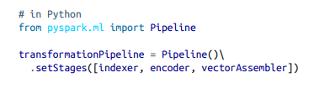
Here, we have three key features: the price, the quantity, and the day of week. Next, we’ll set this up into a pipeline so that any future data we need to transform can go through the exact same process:

Slide 42
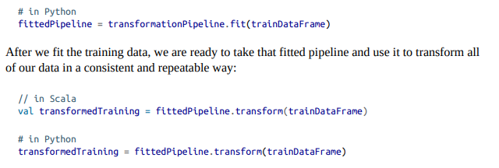
Preparing for training is a two-step process. We first need to fit our transformers to this dataset.
basically our StringIndexer needs to know how many unique values there are to be indexed. After those exist, encoding is easy but Spark must look at all the distinct values in the column to be indexed in order to store those values later on:

Slide 43
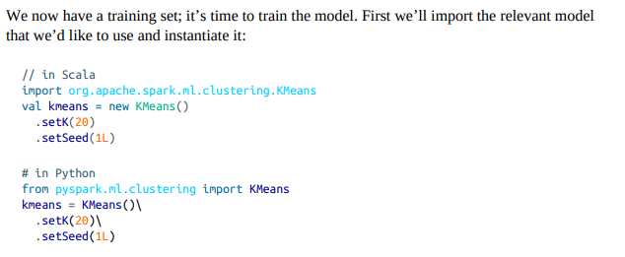

Slide 44
In Spark, training machine learning models is a two-phase process.
First, we initialize an untrained model, and then we train it.
There are always two types for every algorithm in MLlib’s DataFrame API. They follow the naming pattern of Algorithm, for the untrained version, and AlgorithmModel for the trained version. In our example, this is KMeans and then KMeansModel.

Slide 45
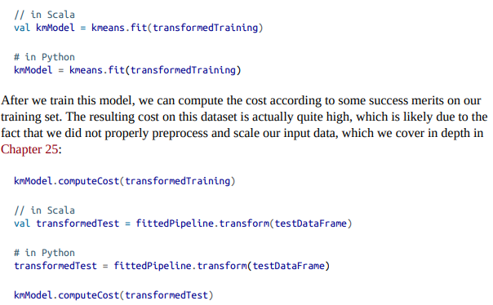

Slide 46
Lower-Level APIs:RDDs
Spark includes a number of lower-level primitives to allow for arbitrary Java and Python object manipulation via Resilient Distributed Datasets (RDDs).
Virtually everything in Spark is built on top of RDDs.
As we will discuss, DataFrame operations are built on top of RDDs and compile down to these lower-level tools for convenient and extremely efficient distributed execution.
There are some things that you might use RDDs for, especially when you’re reading or manipulating raw data, but for the most part you should stick to the Structured APIs.
RDDs are lower level than DataFrames because they reveal physical execution characteristics (like partitions) to end users.

Slide 47
One thing that you might use RDDs for is to parallelize raw data that you have stored in memory on the driver machine.
For instance, let’s parallelize some simple numbers and create a DataFrame after we do so. We then can convert that to a DataFrame to use it with other DataFrames:
// in Scala
spark.sparkContext.parallelize(Seq(1, 2, 3)).toDF()
# in Python
from pyspark.sql import Row
spark.sparkContext.parallelize([Row(1), Row(2), Row(3)]).toDF()

Slide 48
RDDs are available in Scala as well as Python. However, they’re not equivalent. This differs from the DataFrame API (where the execution characteristics are the same) due to some underlying implementation details. We cover lower-level APIs, including RDDs in Unit IV.
As end users, you shouldn’t need to use RDDs much in order to perform many tasks unless you’re maintaining older Spark code.
There are basically no instances in modern Spark, for which you should be using RDDs instead of the structured APIs beyond manipulating some very raw unprocessed and unstructured data.

Slide 49
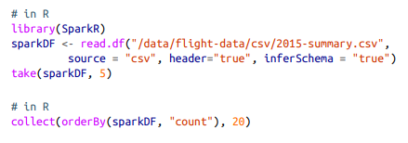
SparkR
SparkR is a tool for running R on Spark. It follows the same principles as all of Spark’s other language bindings. To use SparkR, you simply import it into your environment and run your code.
It’s all very similar to the Python API except that it follows R’s syntax instead of Python.For the most part, almost everything available in Python is available in SparkR:

Slide 50
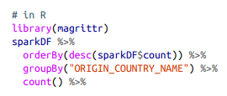

R users can also use other R libraries like the pipe operator in magrittr to make Spark transformations a bit more R-like. This can make it easy to use with other libraries like ggplot for more sophisticated plotting:

Slide 51
Spark’s Ecosystem and Packages
One of the best parts about Spark is the ecosystem of packages and tools that the community has created. Some of these tools even move into the core Spark project as they mature and become widely used.
As of this writing, the list of packages is rather long, numbering over 300—and more are added frequently. You can find the largest index of Spark Packages at spark-packages.org, where any user can publish to this package repository. There are also various other projects and packages that you can find on the web; for example, on GitHub.

